Slide 1
KS2 Netball Challenge
Take part in all 5 challenges and score as many points as you can.
You will work in groups of three for each challenge.
You will Play, Coach and Officiate.
You can watch a video of all of the challenges on this link:
https://www.trenthamacademy.co.uk/academy-life/sports-leaders/

Slide 2
Roles for each challenge
Player- Try to score as many points as possible. Listen to your coach for help.
Coach-Use the top tips card to help the player to score as many points as possible.
Official- Carefully count how many points the player scored. Tell your teacher at the end of the 1 minute, how many they scored.
When everyone in your group has had a go at each role, move on to the next challenge.

Slide 3
Coaches : Remember STEP
Space- change the distance when practicing
Task- Adapt the task
Equipment – Change equipment
People- Individual tasks so no people change required
*** Always think is this Safe ?

Slide 4
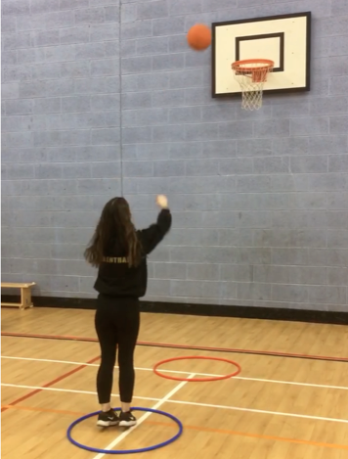
Goal Shooter Challenge
Place one marker 1m away from a Netball post and another one 3m away.
In 1 minute, how many points can you score?
Hit the rim of post from closest marker = 2 points
Score from closest marker = 5points
Hit rim from furthest marker= 3points
Score from furthest marker = 10 points.
*** Avoid using hoops – as children may slip, use flat markers

Slide 5
Goal Shooter: Coach Top Tips
Hold ball in 2 hands above the head
Bend Knees
Push Ball upwards and extend arms upwards towards the target

Slide 6
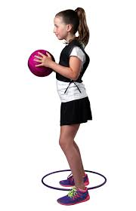
GA Challenge
In one minute score as many points as possible.
Start at least 2m away from a wall.
Every time you receive the ball from the wall, you must pivot before sending it back to the wall.
Every pivot = 1 point.
Collect your own ball.
https://www.youtube.com/watch?v=hjvnN_hLvfw

Slide 7
GA Challenge: Top Tips
Ensure you encourage participant to pivot both ways
Use a chest pass
Ensure the player is balanced before attempting to pivot

Slide 8
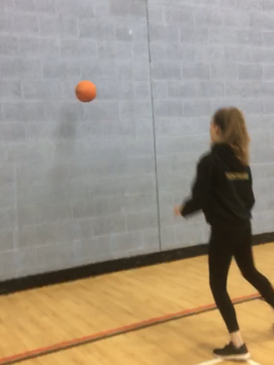
Centre Challenge
In one minute, how many times can you pass and receive the ball from the wall.
Start at least 2m away from the wall.
Try and use a Chest Pass.
You must take at least one step to the side before receiving the ball.
Each time you receive the ball= 2 points.

Slide 9
Centre Challenge: Coach Top Tips
Keep still when you catch the ball
Encourage a variety of passes
Attempt different landings – 1-2 landing and 2 footed landing

Slide 10
Goal Defence Challenge
Set out 3 cones, 3m apart in a triangle shape.
Place a fourth cone in the middle of the triangle.
You must start at the centre cone and hit the balloon in the air.
Whist the balloon is in the air you must run around a cone and back to the centre before the balloon hits the ground.
Each successful hit up and return to the centre cone= 2 points

Slide 11
Goal Defence : Top Tips
Drive off your outside foot
Bend knees .
Prepare with a low centre of gravity
Attempt to plan for one visit
Propelling the balloon higher will give you more time.

Slide 12
Goal Keeper Challenge
Stand with your back to the wall and reach up as high as you can with 2 hands. Mark the wall with chalk.
Stand sideways on to the wall with the chalk in the hand nearest the wall
Jump as high as you can and mark the wall with the chalk.
Measure the difference between your two chalk marks.
Your score will be in cm’s

Slide 13
Goal Keeper: Coach Top Tips
Vertical jump
Stand sideways to the wall
Use arms and knees to drive upwards in a powerful motion
Attempt jump with left hand reaching upwards and then right hand reaching upwards.

Slide 14
Results
Results:
All results must be inputted into the spreadsheet, your teacher has been given.
The top 15 scores from your school will be sent to your local School Games Organiser who will compare your results with other local schools.
They will let you know if you are the highest scoring team in the City.
Your teacher will look at the results to see who is the most improved in your school.

Slide 15
Certificate
Congratulations
___________________________________________
For successfully taking part in our
Bee Netball
_____________
School Games Organiser

