Slide 1
County
Boccia
SEN-Years 3 to 11

Slide 2
Introduction
Pupils can take part in bubbles in lessons or after school or at home.
Pupils work in pairs with a player and a scorer.
Schools return the score for each of the five events via email.
There is a class print off sheet available.
Parents return scores to class teacher from home.
Teacher’s will need to submit results in the year group master sheets which automatically give each pupil a total points score. When submitting results, check the figures on the scoring table first.
Total scores of the best three boys and girls in the year group go forward to county competition.
In the interests of fairness, please read the instructions and encourage athletes to be honest.
Submit scores to your local SGO by the deadline- Friday 25th June 2021
Perform the events indoor if possible unless facility availability forces you outdoors.

Slide 3
Competition Intent
Increase levels of physical activity towards 60 active minutes in school settings and master the fundamental motor skills of running, jumping and throwing.
Develop peer to peer leadership skills and cross curricular work such as measurement, timekeeping and scoring.
It’s an inter school event but can be used as an intra school personal challenge.
Results collected from home rely on honesty.
Reflect one or more of the School Games Values:
Honesty/Determination/Passion/Self Belief/Respect/Teamwork

Slide 4
Virtual Boccia
There are separate competitions for the year groups listed below:
SEN Y3-6
SEN Y7-11

Slide 5
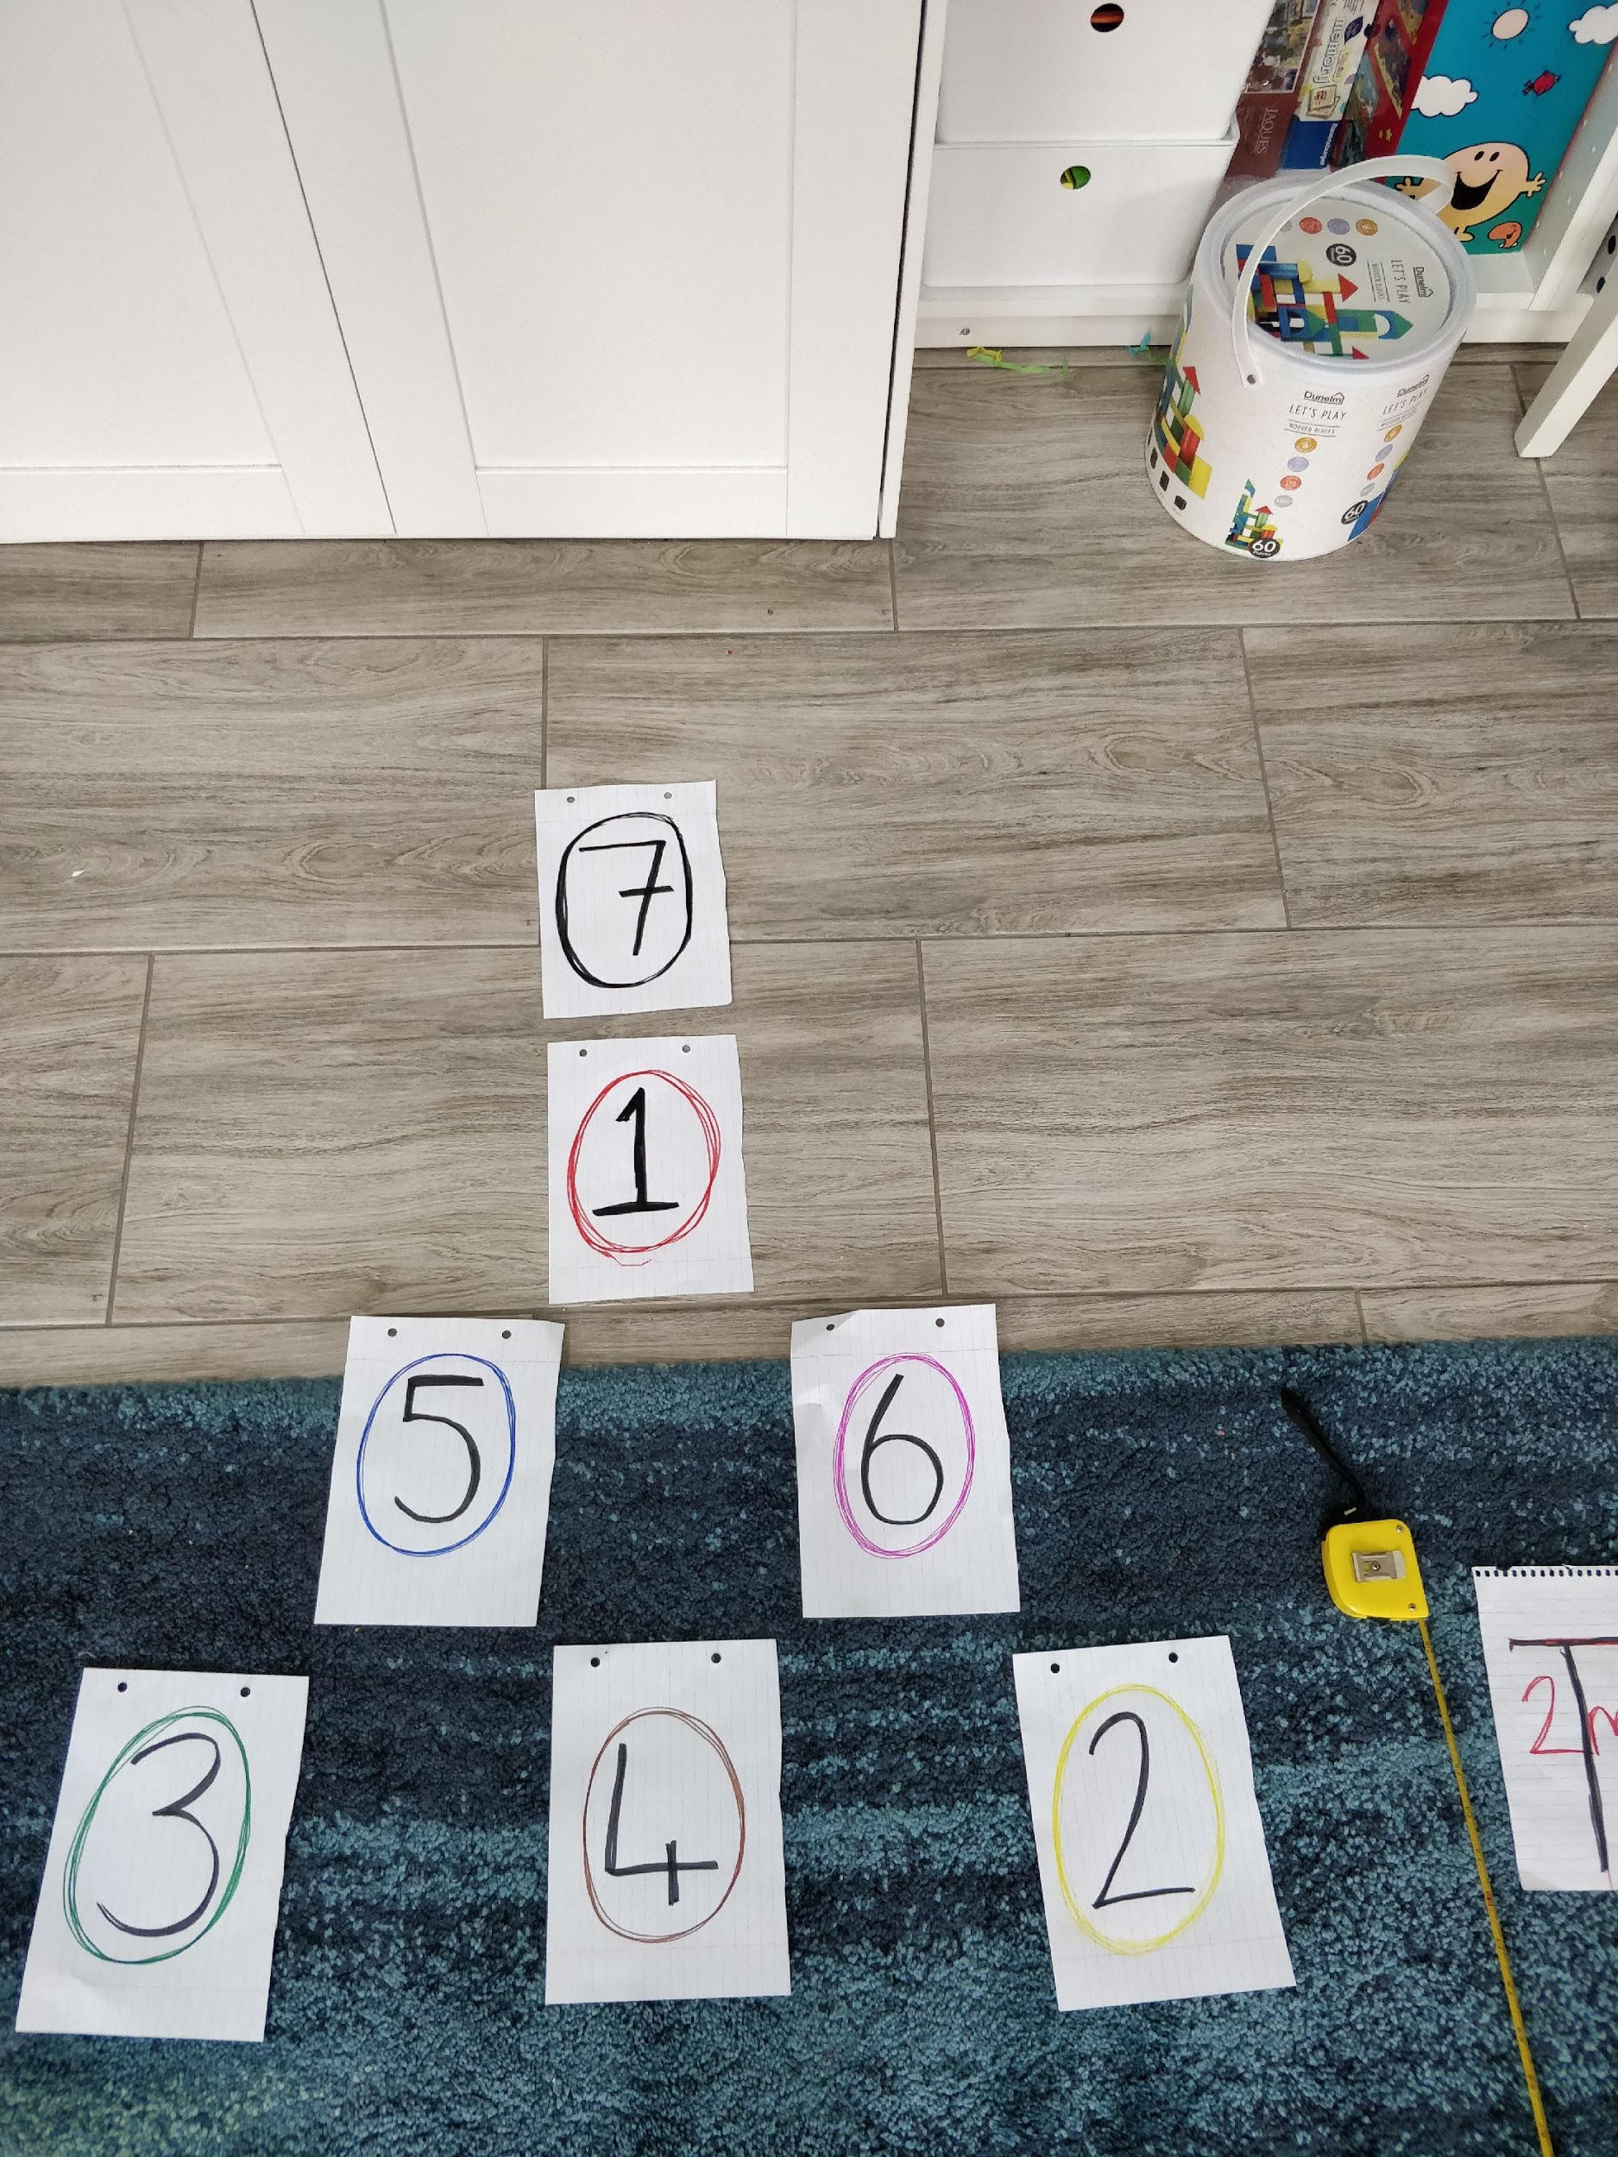
Challenge 1: Boccia Big Break
Place 7 numbered (1-7) markers (suggest A5 sheets of paper) on the floor (as shown in the picture) in a style similar to Snooker. If you’re feeling artistic you can colour the paper similar to Snooker balls.
Set a chair 2metres away as your throwing line.
There is a picture attached showing the layout (or my attempted diagram below)
chair
2metres
2 (yellow) 4 (brown) 3 (green)
5 (blue) 6 (pink)
1 (red)
7 (black)
With 5 bean bags/socks/rolled up balls of paper score as many points as you can, by throwing each bag to land on a marker.
The first piece of paper you hit is the scoring shot. you can hit the same piece of paper more than once.
Each marker is worth the corresponding number of points.
Max possible score 35.
2 metres

Slide 6
Chair
Challenge 2: Flip it
Lay a series of markers 1 meter apart in a straight line, with the first 2m from the throw line.
Place a hoop between the first 2 markers (see picture)
With 5 bean bags/socks/rolled up balls of paper score as many points as you can, by throwing each bag to land in the hoop. Every time you land a ball/bag in the hoop flip the hoop over to between the next 2 markers.
You cannot move the hoop until you land in it.
The first hoop is worth 6, the next is 7 up to 10.
Max possible score is 40.
2 metres
1 metres
1 metres
1 metres
1 metres

Slide 7
Challenge 3: Space Invaders
Lay a series of 15 cones or markers 2 metres from a throwing line (See diagram below).
Using 3 bean bags/tennis balls/boccia balls you have 1 minute to throw and hit as many of the markers as possible, every time you hit a marker- remove it.
After throwing all 3 balls- collect them in. If working with a partner they can remove cones and collect balls in.
Only the first marker a ball hits counts
The first row of cones/markers each score 1 point
The second row scores 3 points each
The 3rd row scores 5pts each
Max Score is 45pts
50cm 50cm
2 metres

Slide 8
Certificate
Congratulations to
___________________________________________
For successfully taking part in our
Virtual Boccia
2020-2021
School Games Organiser

